Slide 1
System Analysis and Design
CSE 307 Sec 1
Instructor: Sabrina Alam
Lecture 11
Designing Effective Input

Slide 2
Learning Objectives
Design functional input forms for users of business systems.
Design engaging input displays for users of information systems.
Design useful input forms for people interacting on the Web.
Design useful input pages for users of intranets, the Web, smartphones, and tablets.

Slide 3
Input Design Objectives
The quality of system input determines the quality of system output
Input design objectives:
  Effectiveness
  Accuracy
  Ease of use
  Consistency
  Simplicity
  Attractiveness
Notes:
Effectiveness—all serve specific purposes for users of the information system.
Accuracy—design that ensures proper completion.
Ease of use—straightforward and require no extra time to decipher.
Consistency—group data similarly from one application to the next.
Simplicity—keeping designs uncluttered in a manner that focuses the user’s attention.
Attractiveness—appealing design.

Slide 4
Major Topics
Input design
Form design
Display design
GUI screen design
GUI controls
Web design guidelines

Slide 5
Good Form Design
Make forms easy to fill in
Ensure that forms meet the purpose for which they are designed
Design forms to assure accurate completion
Keep forms attractive
Notes:
Forms often serve as source documents for users or for input to ecommerce applications that humans must enter.

Slide 6
Make Forms Easy to Fill in
Form flow
Seven sections of a form
Captioning
Notes:
Design forms with proper flow, from left to right and top to bottom.
Group information logically using the seven sections of a form.
Provide people with clear captions.

Slide 7
Form Flow
Can minimize the time and effort expended by employees in form completion
Should flow from left to right and top to bottom
Notes:
Illogical flow takes extra time and is frustrating.

Slide 8
Seven Sections of a Form
Heading
Identification and access
Instructions
Body
Signature and verification
Totals
Comments

Slide 9
Caption Types
Line caption
  Putting the caption on the same line or below the line
Boxed caption
  Providing a box for data instead of a line
Check off caption
  Lining up choices or alternatives vertically
Horizontal check off caption
  Lining up choices or alternatives horizontally
Table caption
  Work well in the body of a form
Combination
Notes:
Captions tell the person filling out the form what to put in a blank line, space, or box.

Slide 10
Major Captioning Alternatives
(Figure 12.2)

Slide 11
Meeting the Intended Purpose
Systems analysts may use different types of specialty forms for different purposes
Specialty forms
  Multiple-part
  Continuous-feed
  Perforated
Notes:
Sometimes it is desirable to provide different information to different departments or users but still share some basic information.

Slide 12
Ensuring Accurate Completion
To reduce error rates associated with data collection, forms should be designed to assure accurate completion
Design forms to make people do the right thing with the form

Slide 13
Keeping Forms Attractive
Aesthetic forms draw people into them and encourage completion
Forms should look uncluttered, and elicit information in the expected order
Using different fonts and line weights within the same form can help make it more attractive for users
Notes:
Proper layout and flow contribute to a form’s attractiveness.
Type fonts and line weights are useful design elements for capturing attention and making people feel secure that they are filling in the form correctly.

Slide 14
Computer-Assisted Form Design
Numerous form design packages are available for desktop systems—there are tools (such as Omniform by ScanSoft) to set up:
  Fields
  Check boxes
  Lines
  Boxes
12-<number>
Notes:
Omniform by ScanSoft is an example of a design package.

Slide 15
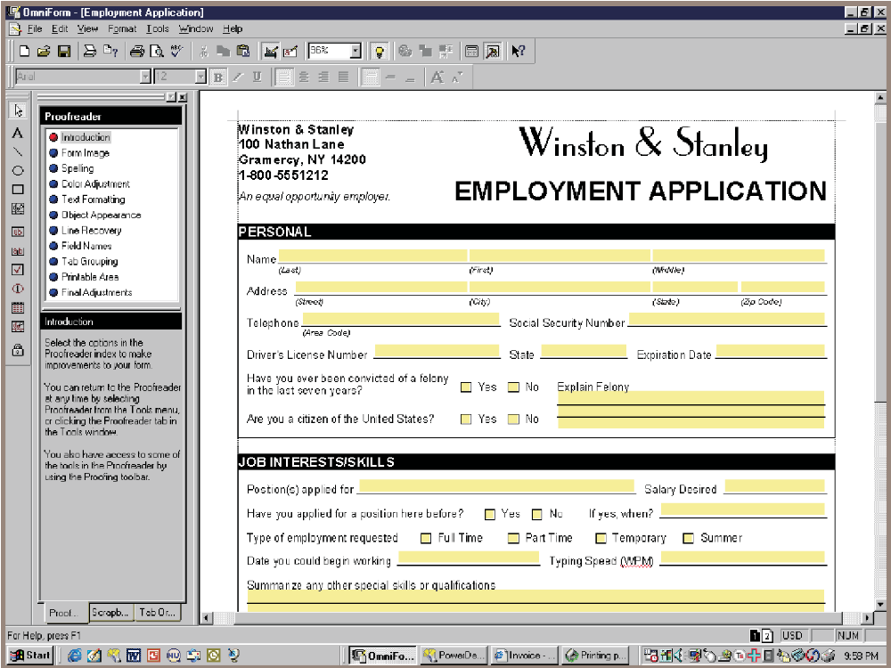
Omniform from ScanSoft Allows the User to Take an Existing Form, Scan It into the Computer, and Define Fields So the Form Can Be Easily Filled out on a PC (Figure 12.3)

Slide 16
Controlling Business Forms
Make sure that each form in use fulfills its specific purpose
Make sure that the specified purpose is integral to organizational functioning
Prevent duplication of information collected and of the forms that collect it
Design effective forms
Decide on how to reproduce forms in the most economical way
Establish procedures that make forms available, at the lowest possible cost

Slide 17
Good Display and Web Forms Design
Keep the display simple
Keep the display presentation consistent
Facilitate user movement among display screens and pages
Create an attractive and pleasing display
Notes:
Differences for displays:
presence of cursor
can include context-sensitive help
hyperlinks

Slide 18
Keeping the Display Simple
Heading
Body
Comments and instructions
Notes:
The display should show only that which is necessary for the particular action being undertaken.
Heading—contains titles of software and open files, pull-down menus, and icons that do certain tasks.
Body—used for data entry and is organized from left to right and top to bottom.
Comments and instructions—displays a short menu of commands that remind the user of basics.

Slide 19
Keeping the Display Consistent
Locate information in the same area each time a new display is accessed
Information that logically belongs together should be consistently grouped together
Information should not overlap from one group to another

Slide 20
Facilitating Movement
The three-clicks rule says that users should be able to get to the screens they need within three mouse or keyboard clicks
Movement among screens:
  Scrolling by using arrows or PgDn keys
  Context-sensitive pop-up windows
  Onscreen dialogue

Slide 21
Designing an Attractive and Pleasing Display
Should draw users into them and hold their attention
Use logical flows in the plan to your display pages
Color or shaded boxes and creating three-dimensional boxes and arrows
Notes:
If users find displays appealing they are likely to be more productive, need less supervision, and make fewer errors.

Slide 22
Using Icons in Screen Design
Icons are pictorial, onscreen representations symbolizing computer actions that users may select using a mouse, keyboard, lightpen, touch screen, or joystick
Shapes should be readily recognizable
Icons for a particular application should be limited to 20 recognizable shapes
Use icons consistently throughout
Notes:
Icons are pictorial, onscreen representation symbolizing computer actions that users may select using a mouse, keyboard, lightpen, touch screen or joystick—serve function similar to words.
Shapes should be readily recognizable—so the user is not required to master a new vocabulary.
Icons for a particular application should be limited to 20 recognizable shapes—so that icon vocabulary is not overwhelming and a coding scheme can still be realized.
Use icons consistently throughout—this ensures continuity and understanding.

Slide 23
Graphical User Interface (GUI) Controls
Text boxes
Check boxes
Option or radio buttons
List and drop-down list boxes
Sliders and spin buttons
Image maps
Text area
Message boxes
Notes:
GUI is sometimes referred to as point-and-click.

Slide 24
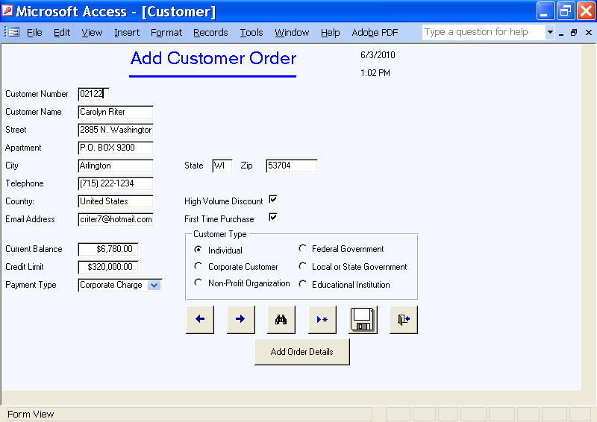
The Designer Has Many GUI Components that Allow Flexibility in Designing Input Screens for the Web or Other Software Packages: This Example Is from Microsoft Access (Figure 12.4)

Slide 25
Text Boxes
Text boxes should be large enough to accommodate all the characters
Captions should be to the left of the text box
Character data is left-aligned within the box
Numeric data is right-aligned
Notes:
A rectangle represents a text box and is used to outline data entry and display fields.

Slide 26
HTML5 Browsers Features
Placeholder puts a small amount of help text into a text box, displaying in a lighter color
When the cursor is placed in the field the text vanishes
New text boxes:
  Email
  Telephone
  URL, a Web address

Slide 27
HTML5 Browsers Features
These appear as normal text boxes on a computer
When used on a tablet or smartphone, they can be used to customize the pop-up keyboard
  Telephone number, the keyboard layout changes to a number pad
  A URL, the keyboard includes a .com button
  An email address, the keyboard includes an @ symbol
Helps the user enter data quickly and accurately

Slide 28
HTML5 Browsers Features
A datalist displays a drop-down list of predefined suggestions to make entry easier for the user
As the user begins to type the first few letters, the datalist is displayed
The user can choose one of the items in the list to make a selection
This is used in the autocomplete function

Slide 29
HTML5 Browsers Features
A calendar control to select a date, a date and time, or a local date and time
Selecting dates from a pop-up calendar is easier and less error-prone than entering text

Slide 30
Check Boxes
Check boxes are used for nonexclusive choices
Check box text or label is placed to the right of the check box
If there are more than ten check boxes, group together in a bordered box
Notes:
Check boxes contain an X or are empty, corresponding to whether or not the user selected the option.

Slide 31
Option Buttons
Option or radio buttons are used for exclusive choices
Choices are listed to the right of the button, in some sequence
Often they are placed in a rectangle called an option group
If more than six option buttons are used, a list box or drop-down list box should be implemented
Notes:
A circle called an option button or a radio button, is used to select exclusive choices.

Slide 32
List and Drop-Down List Boxes
Used when there is little room available on the page
If there is a commonly selected choice, it is usually displayed in the drop-down list by default
Notes:
A list box displays several options that may be selected with the mouse.

Slide 33
Tab Control Dialogue Boxes
Create a separate tab for each unique feature
Place the most commonly used tabs in front and display them first
Consider including three basic buttons in your design:
  OK
  Cancel
  Help

Slide 34
Sliders, Spin Buttons, and Image Maps
Sliders and spin buttons are used to change data that have a continuous range of values
Image map fields are used to select values within an image
Notes:
Sliders and spin buttons give users more control when choosing values.
Image maps are used when creating web pages containing maps with instructions to click in a certain area in order to view a detailed map of the region.

Slide 35
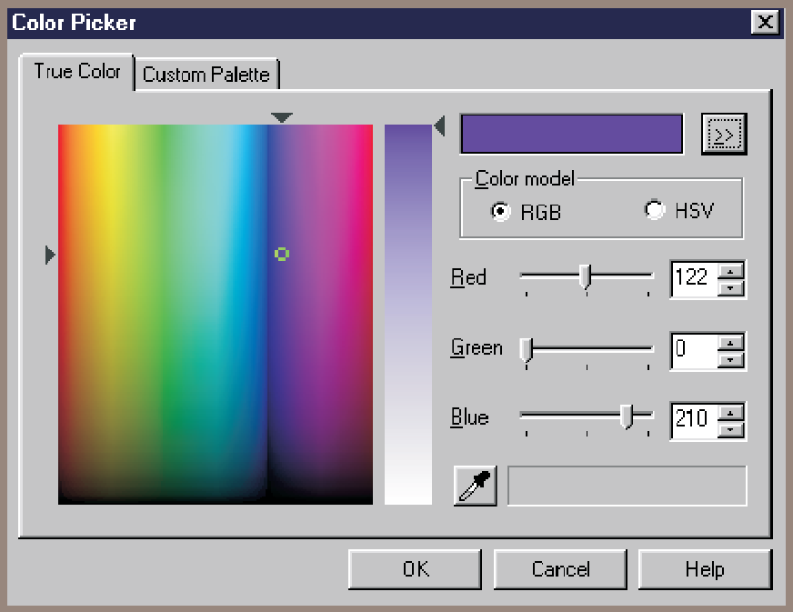
Sliders and Spin Buttons Are Two GUI Components the Analyst Can Use to Design Input Screens (Figure 12.5)

Slide 36
Text Area
A text area is used for entering a larger amount of text
Can view data larger then the box area
Handling text:
  Hard return is used to force new lines
  Use word wrap within the text area
Notes:
Text areas can include a number of rows, columns, and scroll bars that allow the user to enter and view text greater than the size of the box area.

Slide 37
Message Boxes and Command Buttons
Message boxes are used to warn users and provide feedback messages in a dialog box
Command buttons (Calculate Total, Add Order, OK) perform an action when the user selects it
Notes:
Each message box should appear in a rectangular window and should spell out the message so the user knows precisely what is happening and what actions are possible.
Calculate Total, Add Order, OK, are examples of command buttons.

Slide 38
Form Controls and Values
Each control in a GUI interface stores data associated with the control
Web pages use a name and value pair that are transmitted to the server or in an email sent along with the form

Slide 39
Hidden Fields
Not visible to the viewer
Do not take up any space on the web page
Can only contain a name and value
Used to store values sent from one Web form to the server
Notes:
Used to retain information about the type of browser being used; the viewer’s operating system, and so on. Sometimes a hidden field will contain a key field used to locate a record for the customer or the browsing session.

Slide 40
Event-Response Charts
Used to:
  List the variety of events that can occur
  Show what should happen
  Build a Web form that requires minimal action from the user
  Explore improvements to the web page
Events may be used to:
  Control navigation between web pages
  Change the contents of drop-down lists
  Note: Events may be clicking a button, changing a value, the field receives focus, blurring a field, loading the web page, detecting keystrokes and so on.
Notes:
Events may be clicking a button, changing a value, the field receives focus, blurring a field, loading the web page, detecting keystrokes and so on.

Slide 41
Dynamic Web Pages
Web pages that change themselves as the result of some user action
Advantage
  Modify themselves quickly
Disadvantage
  Will not work if JavaScript is turned off
  Dynamic web pages may not be compliant with the American Disabilities Act
Notes:
Dynamic web pages use JavaScript to modify some part of the web page, or a style.
Modify themselves quickly—since they have fewer interruptions to send and receive data from the server.

Slide 42
Three Dimensional Web Pages
Use stacked layers
Code is moved in front of the web page
Code may be created using JavaScript
Analyst must determine when to use layers

Slide 43
Three Dimensional Web Pages
Analyst must determine:
  How is the layer built?
  What events cause the layer to be created?
  What events remove the layer?
  Where should the block be placed?
  The size of the block?
  How to frame the region?
  What happens when an option is selected?

Slide 44
Ajax (Asynchronous JavaScript and XML)
Uses JavaScript and XML
Allows Web developers to build a web page that works like a traditional desktop program
The data may be either a small text file or an XML document containing many customers or repeating data
Has the advantage of making the Web work faster and of providing a smoother viewing experience for users
The disadvantages are that JavaScript must be enabled and the web page may violate the American Disabilities Act

Slide 45
Color
Color allows you to:
  Contrast foreground and background
  Highlight important fields
  Feature errors
  Highlight special code input
  Call attention to other special attributes
Notes:
Color is an appealing and proven way to facilitate users with tasks requiring computer input.
Color allows you to:
contrast foreground and background
highlight important fields
feature errors
highlight special code input
call attention to other special attributes

Slide 46
Color
The five most legible foreground/background color combinations:
  Black on yellow
  Green on white
  Blue on white
  White on blue
  Yellow on black
Notes:
Color is an appealing and proven way to facilitate users with tasks requiring computer input.
Color allows you to:
contrast foreground and background
highlight important fields
feature errors
highlight special code input
call attention to other special attributes

Slide 47
Website Page Design
Provide clear instructions
Demonstrate a logical entry sequence for fill-in forms
Use a variety of text boxes, push buttons, radio buttons, drop-down lists, and other GUI features
Provide a scrolling text box if you are uncertain how much text will be entered

Slide 48
Website Page Design (continued)
Include two basic buttons: Submit and Clear
If the form is lengthy, divide it into several simpler forms on separate pages
Create a feedback screen that lists error messages if a form has not correctly been filled out

Slide 49
Ecommerce Applications
Ecommerce applications involve more than just good designs of websites.
Customers need to feel confident in the site
  Shopping cart
  Customer can edit the quantity of the item ordered or can remove the item entirely
Notes:
Customers need to feel confident they are buying the correct quantity, that they are getting the right price, and that the total cost of an Internet purchase, including shipping charges, is what they expect.
The most common way to show establish confidence is to use the metaphor of a shopping cart or shopping bag. An important feature of the shopping cart is that the user can edit the quantity of the item ordered or can remove the item entirely.

Slide 50
Summary
Guidelines for well-designed input forms:
  Forms must be easy to fill out
  Forms must meet the purpose for which they are designed
  Forms must be designed to ensure accurate completion
  Forms must be pleasing and attractive

Slide 51
Summary (continued)
Guidelines for well-designed displays:
  Displays must be kept simple
  Displays must be consistent in presentation
  Design must facilitate movement between pages
  Displays must be attractive

Slide 52
Summary (continued)
Guidelines for Web fill-in forms:
  Provide clear instructions
  Demonstrate a logical entry sequence for fill-in forms
  Use a variety of text boxes, push buttons, drop-down menus, check boxes, and radio buttons
  Provide a scrolling text box if you are uncertain about how much space users will need to respond to a question

Slide 53
Summary (continued)
Guidelines for Web fill-in forms (continued):
  Prepare two basic buttons on every Web fill-in form: Submit and Clear Form
  If the form is lengthy and the users must scroll extensively, divide the form into several simpler forms on separate pages
  Create a feedback screen that highlights errors in an appropriate color and refuses submission of the form until mandatory fields are correctly filled in
12-<number>

Slide 54

Copyright © 2014 Pearson Education, Inc.
Publishing as Prentice Hall
1-<number>

Slide 55
END OF
Lecture 11

